Slide 1




Which is the best?
Comparing whether Netflix, HBOMax or Prime Video has the most IMDB top movies.
By: Hector Ladero Rivas and Sarah Green

Slide 2
Introduction:
Netflix, HBOMax and Amazon Prime comparison.
Netflix timeline of number of users.
Worldwide distribution
Number of movies for each streaming service.
Finding how many top movies are in each of the three streaming services.

Slide 3



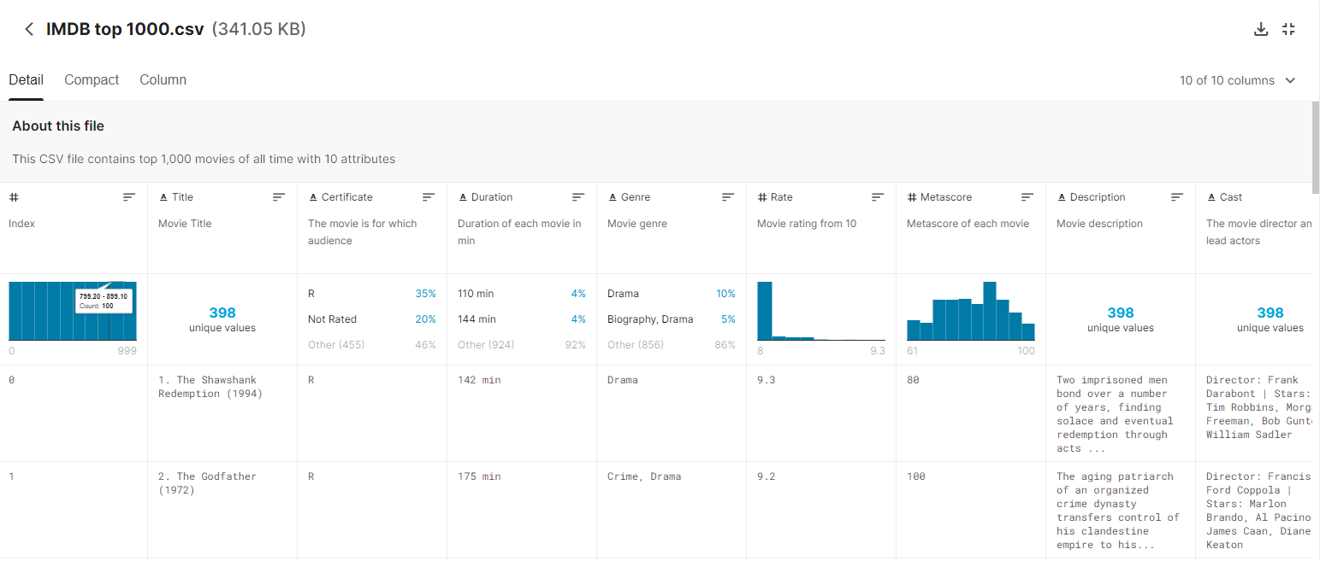
Getting the data:
Using Kaggle, we pulled a CSV file with the top 1000 movies according to IMDB.
Scraping the website: www.reelgood.com, we grabbed the current movies from Netflix, Amazon Prime and HBOMax.

Slide 4
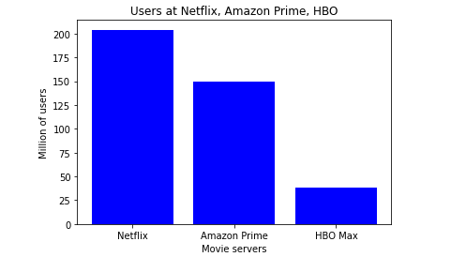
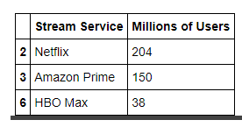
Breakdown of the subscribers:

Slide 5
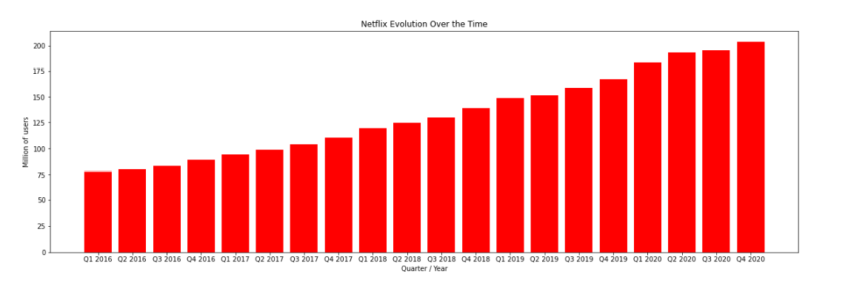
Netflix Evolution:

Slide 6
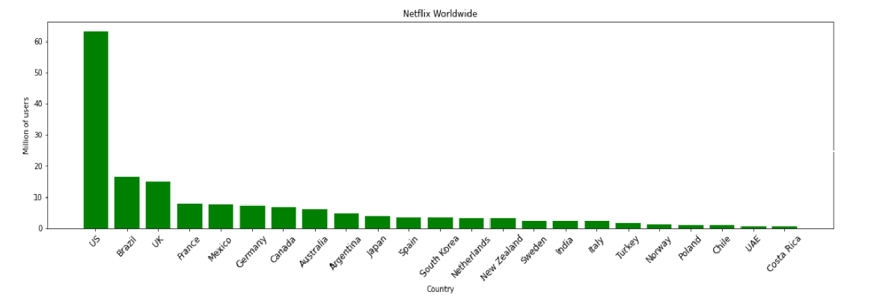
Netflix Worldwide

Slide 7
Extract
Service | Rows of Data
IMDB-CSV | 1000
Netflix | 1500
HBOMax | 450
Prime Video | 500
Using the CSV file that we found on Kaggle, we were able to directly pull that file into Jupyter Notebook to transform.
For the reelgood.com website we decided on a web-scraping loop, we had the machine click through pages on the website to extract the data that we needed.
Extracted HTML code from www.businesssofapps.com/data/Netflix/statisics
Was able to obtain statistical information on all of the different streaming services.

Slide 8


Transform
CSV:
Removed duplicated data.
Dropped unnecessary rows
Renamed headers
Netflix, HBOMax and Prime:
Removed duplicated data.
Dropped unnecessary rows.
Renamed headers
With all the clean data, we joined the IMDB csv with each of the streaming services to see which movies were in both.

Slide 9

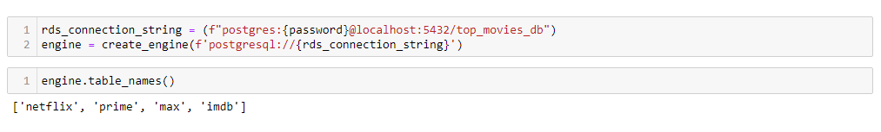
Load
We chose to use PgAdmin to create our database. We created a table for each of the data categories we had [Netflix, HBOMax, Prime and IMDB].
We then linked the database tables to our data in Jupyter Notebook using sqlalchemy.

Slide 10
Who has the most top movies?
Total Number of Top Movies:
40
Total Number of Top Movies:
43
Total Number of Top Movies:
76

Slide 11
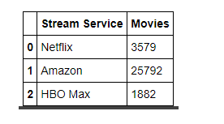
Conclusion:
Limitations:
Not capturing all streaming services.
Limited number of data scrapped.

Slide 12
Questions?

